Slide 1
GaAs and CsKSb Photocathodes for DC Gun
Xianghong Liu
Cornell University

Slide 2
Outline
GaAs photocathode
  DC Gun of ERL photoinjector
  Preparation procedure
  Performance
    Quantum efficiency
    Temporal response
    Transverse energy
    Surface roughening due to heating
    Lifetime
  challenges
CsKSb photocathode

Slide 3
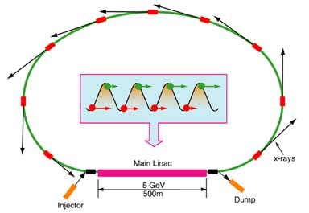
Energy Recovery Linac (Linear Accelerator)
ERL: Electrons return their energy to the RF cavity before being dumped
Photoemission DC gun is a key component of the ERL
ERL can be used for
  CW ultra-bright x-ray sources; high power FELs
  Electron-ion colliders and ion coolers
  Ultrafast electron diffraction, etc.

Slide 4
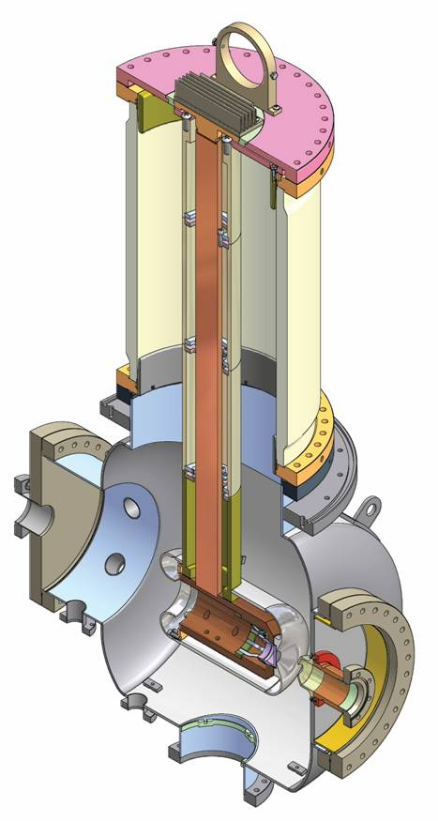
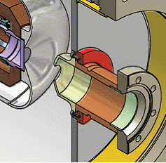
DC Gun of Photoinjector
750 kV DC high voltage
>> MV/m at cathode surface
Photo-
cathode

Slide 5

Preparation procedure
GaAs wafer from AXT, Zn doped to ~1x10¹⁹ cm⁻³, 2° off 100 face
Preparation before loading into the preparation system
  Cut to size
  Acetone and trichloroethylene cleaning to completely remove wax
  H2SO4:H2O2:H2O etching (to some wafers on test system)
  Anodization and partial removal
  to define active area
In-vacuum cleaing
  Atomic hydrogen cleaning (at 350 °C, using Oxford thermal gas cracker)
  High temperature cleaning (at ~600 °C)
Activation using Cs-NF3 “yo-yo” process to max QE (negative electron affinity (NEA) achieved)
Loading into the gun

Slide 6
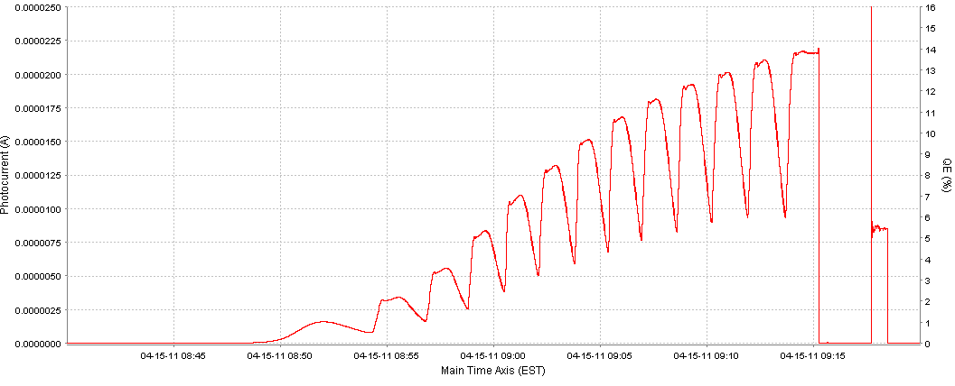
Cs-NF₃ “Yo-Yo” activation
Cs
NF₃

Slide 7
Quantum Efficiency
Over 10% QE (at 532nm) can be routinely obtained (as high as 18% has been achieved)
  e.g. 1% QE = ~ 4 mA per W laser power (at 532 nm)
High temperature cleaning is critical for obtaining higher QE
QE tends to increase with more cleaning cycles

Slide 8
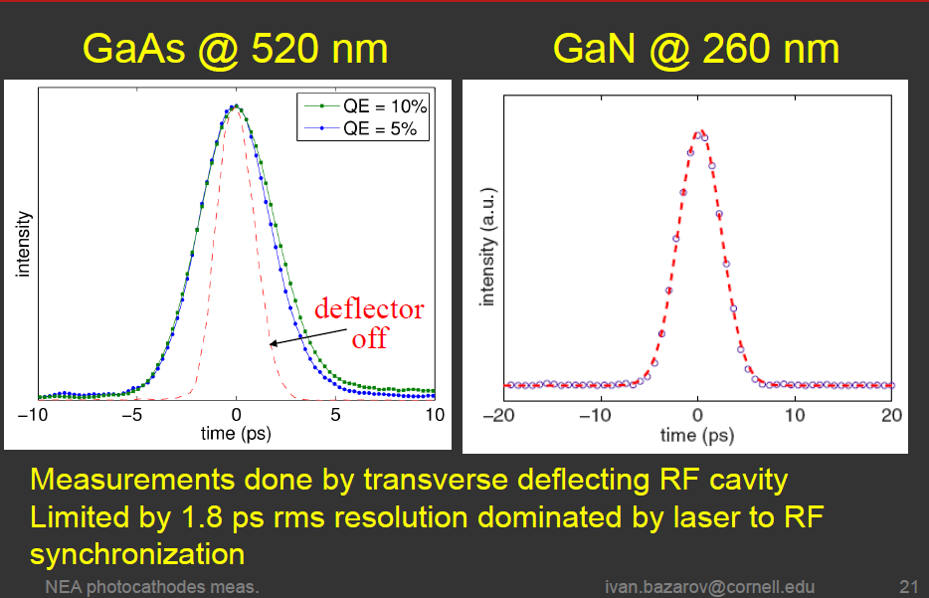
Response time < 1 ps

Slide 9
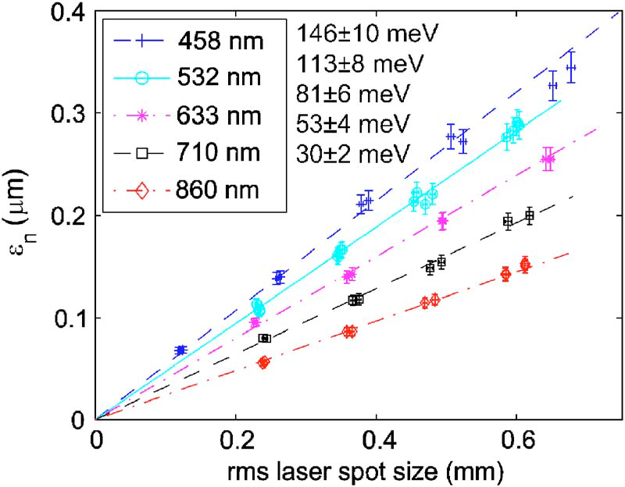
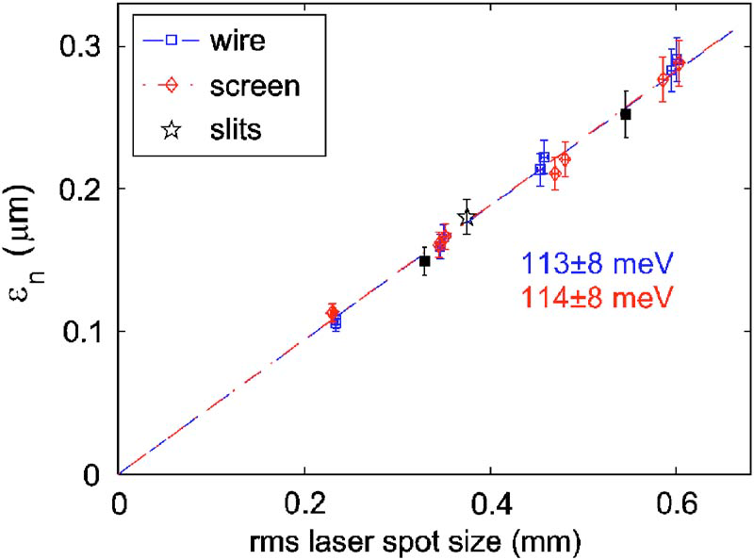
Transverse energy: cold electron beams
Comparison between different emittance measurement
techniques for GaAs at 532 nm
I.V. Bazarov, et al, J. Appl. Phys. 103, 054901 (2008)

Slide 10
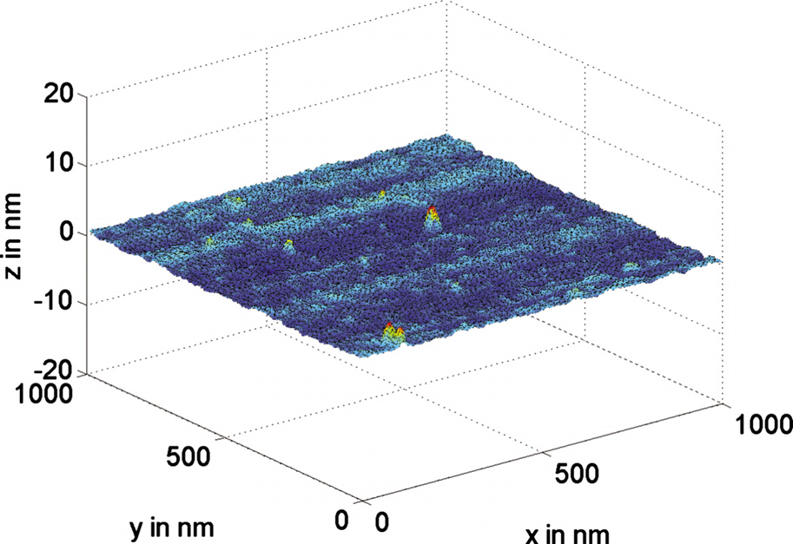
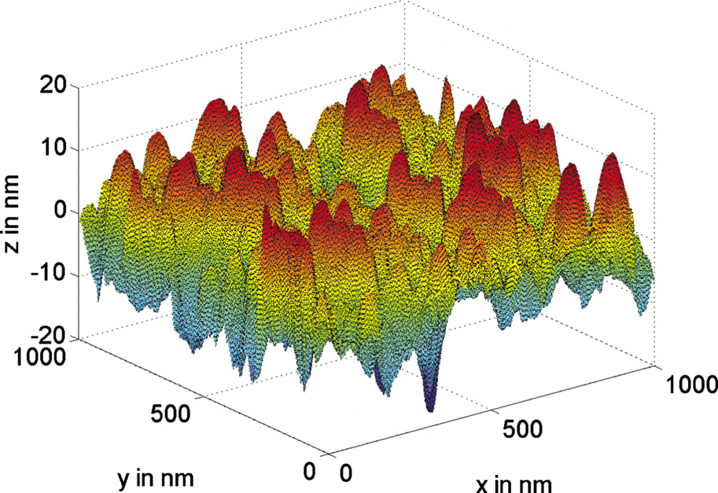
Surface roughening due to heating at temperature above 580°C
AFM image of surface of atomically polished GaAs wafer before heat cleaning
After use in Cornell dc photoemission gun (many times of heat cleaning/activation)
S. Karkare and I. Bazarov, Appl. Phys. Lett. 98, 094104 (2011)

Slide 11
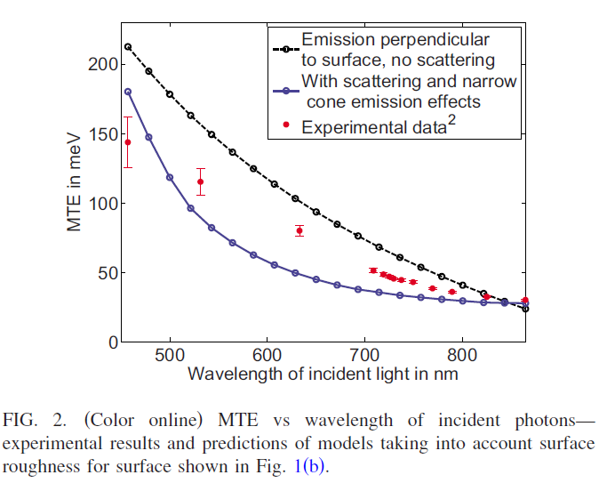
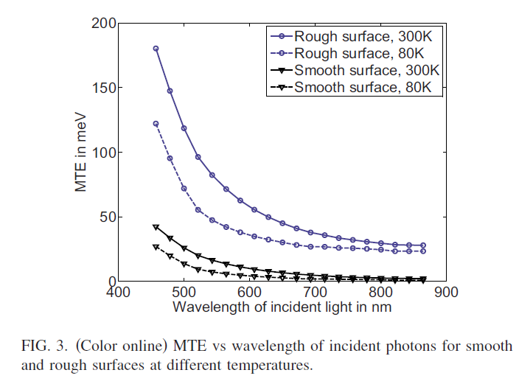
Rough surface increases MTE significantly
S. Karkare and I. Bazarov, Appl. Phys. Lett. 98, 094104 (2011)

Slide 12
Lifetime
Dark lifetime
  10s to 100s hours in prep chamber
  Much better inside the gun (better vacuum)
  Cause of QE decay
    Loss of Cs on surface?
    More likely, surface poisoning (by residual gases)
  Add more Cs to recover QE
Operational lifetime
  Short at high beam current (> 5 mA)
  Better at low beam current in term of hours
  Not a constant either in terms of drawn charge (C cm⁻²)
  Cause of QE decay: implantation/sputtering by back-bombarding ions
    + (faster) surface effect?
  Recesiation can recover QE mostly except area near center after high beam current runs

Slide 13
1/e lifetime at a high current run
(in terms of hour and coulomb)
11/16/2010
15 min
15 C
8 min
3 C
1 hr
60 C
2.5 hr
110 C

Slide 14
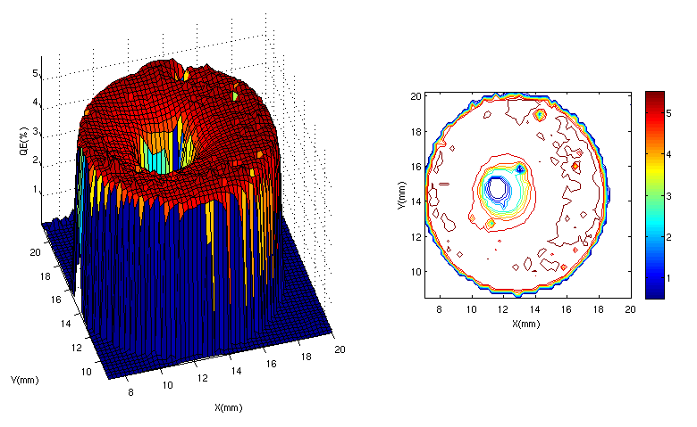
Damage by ion back bombardment
QE can’t be recovered by cleaning/reactivation

Slide 15
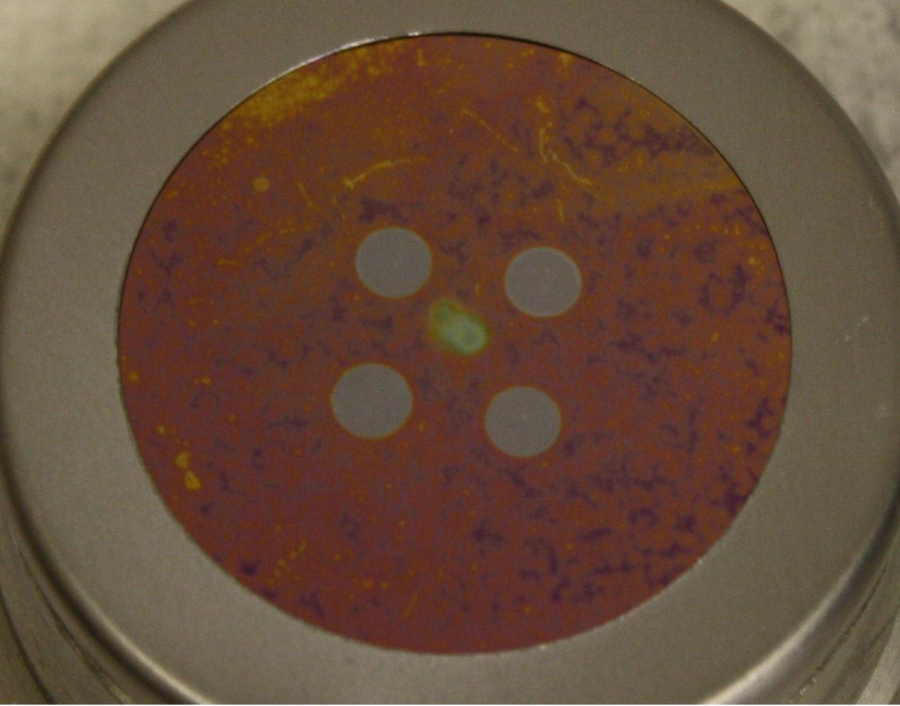
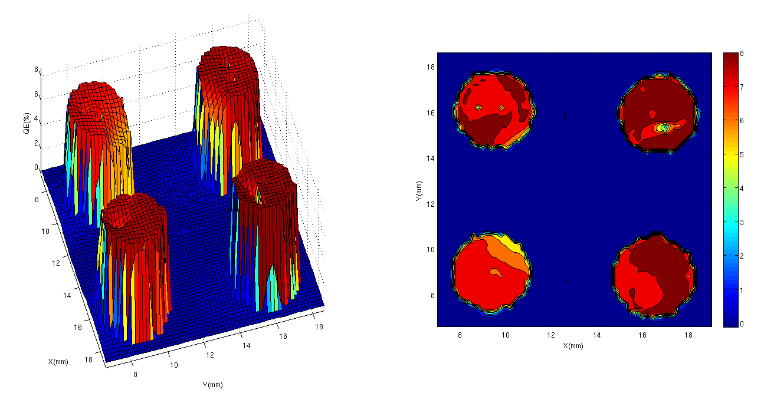
Using cathode off-center

Slide 16
Challenges
Lifetime
  Need improvement for high beam current operation
Surface roughening due to heat cleaning
  Looking into other options, e.g. mainly H-atom cleaning, epitaxially grown GaAs
Ion back bombardment causes non recoverable damage on QE
  Improve vacuum inside the gun and in the beam line beyond the anode
  Anode biasing or other ion clearing mechanism can suppress ions from down stream of anode

Slide 17
CsKSb cathode has much longer lifetime than GaAs
(bulk vs surface)
Growth procedure:
The substrate is heated to 600˚C to remove the hydrogen passivation from the Si surface;
Temperature is lowered to approximately 80 ˚C and then evaporation of 10 nm of antimony is performed;
Evaporation of the K is carried out while the substrate is slowly cooling down and the quantum yield is constantly measured until a peak on the photocurrent is reached;
When the substrate temperature falls below 40˚C Cs evaporation starts until the photocurrent reaches a maximum.

Slide 18
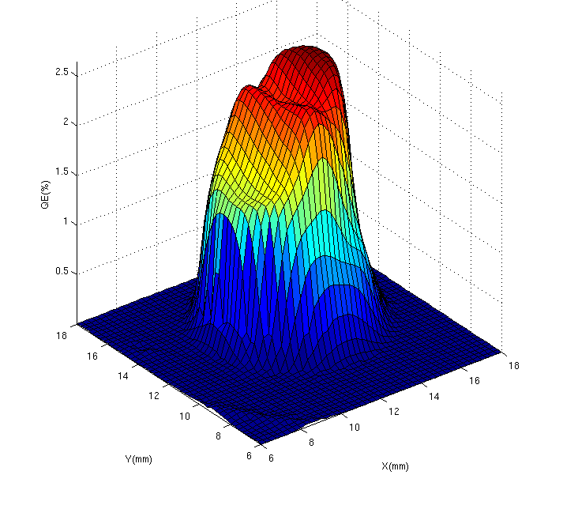
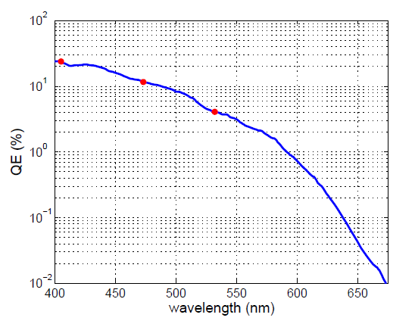
CsKSb: QE vs Wavelength
Red dots indicates wavelengths used for thermal emittance measurements (next slides)
I. Bazarov et al, APL (2011), submitted

Slide 19
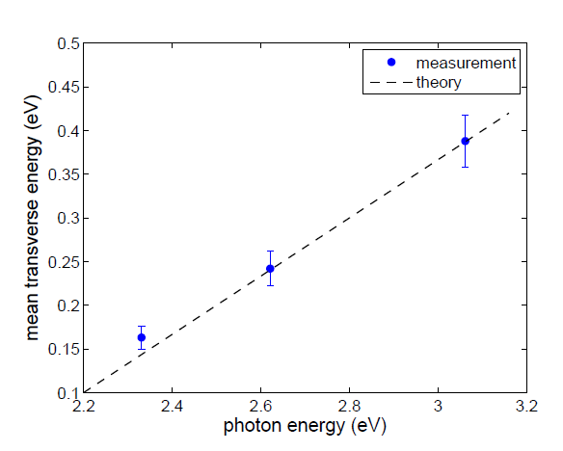
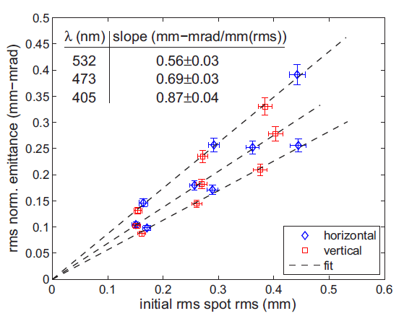
CsKSb cathode: mean transverse energy
I. Bazarov et al, APL (2011), submitted

Slide 20
Acknowledgements
I.V. Bazarov
L. Cultrera
B.M. Dunham
S. Karkare
Y. Li
K.W. Smolenski

